Slide 1
William Stallings
Computer Organization and Architecture
7th Edition
Chapter 12
CPU Structure and Function

Slide 2
CPU Structure
CPU must:
  Fetch instructions
  Interpret instructions
  Fetch data
  Process data
  Write data
Notes:
22

Slide 3
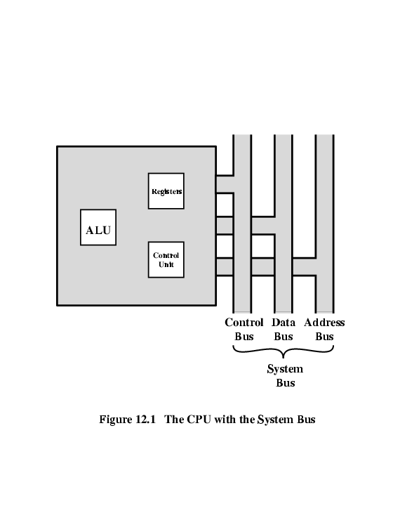
CPU With Systems Bus

Slide 4
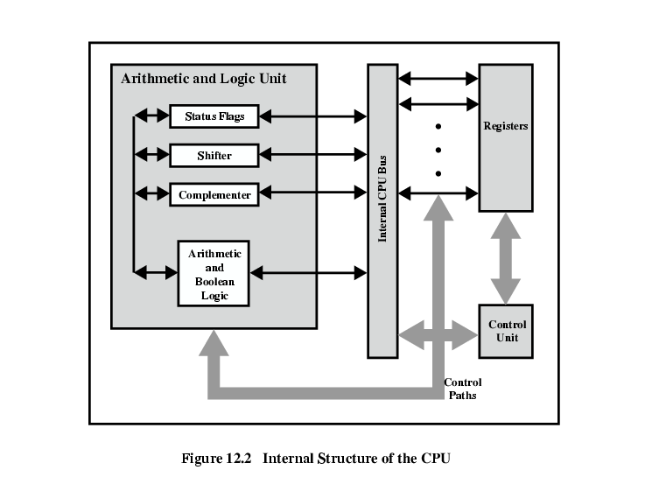
CPU Internal Structure

Slide 5
Registers
CPU must have some working space (temporary storage)
Called registers
Number and function vary between processor designs
One of the major design decisions
Top level of memory hierarchy
Notes:
23

Slide 6
User Visible Registers
General Purpose
Data
Address
Condition Codes
Notes:
24

Slide 7
General Purpose Registers (1)
May be true general purpose
May be restricted
May be used for data or addressing
Data
  Accumulator
Addressing
  Segment
Notes:
25

Slide 8
General Purpose Registers (2)
Make them general purpose
  Increase flexibility and programmer options
  Increase instruction size & complexity
Make them specialized
  Smaller (faster) instructions
  Less flexibility
Notes:
26

Slide 9
How Many GP Registers?
Between 8 - 32
Fewer = more memory references
More does not reduce memory references and takes up processor real estate
See also RISC
Notes:
27

Slide 10
How big?
Large enough to hold full address
Large enough to hold full word
Often possible to combine two data registers
  C programming
  double int a;
  long int a;
Notes:
28

Slide 11
Condition Code Registers
Sets of individual bits
  e.g. result of last operation was zero
Can be read (implicitly) by programs
  e.g. Jump if zero
Can not (usually) be set by programs
Notes:
29

Slide 12
Control & Status Registers
Program Counter
Instruction Decoding Register
Memory Address Register
Memory Buffer Register
Revision: what do these all do?
Notes:
30

Slide 13
Program Status Word
A set of bits
Includes Condition Codes
Sign of last result
Zero
Carry
Equal
Overflow
Interrupt enable/disable
Supervisor
Notes:
31

Slide 14
Supervisor Mode
Intel ring zero
Kernel mode
Allows privileged instructions to execute
Used by operating system
Not available to user programs
Notes:
32

Slide 15
Other Registers
May have registers pointing to:
  Process control blocks (see O/S)
  Interrupt Vectors (see O/S)
N.B. CPU design and operating system design are closely linked
Notes:
33

Slide 16

Example Register Organizations

Slide 17
Instruction Cycle
Revision
Stallings Chapter 3
Notes:
35

Slide 18
Indirect Cycle
May require memory access to fetch operands
Indirect addressing requires more memory accesses
Can be thought of as additional instruction subcycle

Slide 19
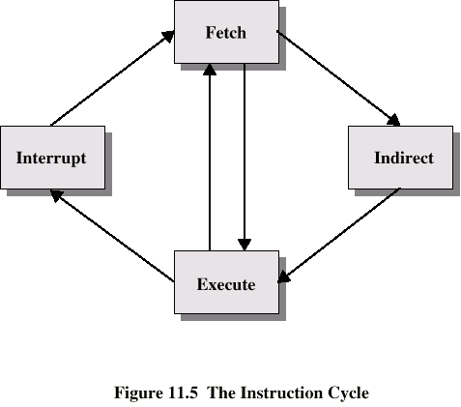
Instruction Cycle with Indirect

Slide 20

Instruction Cycle State Diagram

Slide 21
Data Flow (Instruction Fetch)
Depends on CPU design
In general:
Fetch
  PC contains address of next instruction
  Address moved to MAR
  Address placed on address bus
  Control unit requests memory read
  Result placed on data bus, copied to MBR, then to IR
  Meanwhile PC incremented by 1

Slide 22
Data Flow (Data Fetch)
IR is examined
If indirect addressing, indirect cycle is performed
  Right most N bits of MBR transferred to MAR
  Control unit requests memory read
  Result (address of operand) moved to MBR

Slide 23

Data Flow (Fetch Diagram)

Slide 24

Data Flow (Indirect Diagram)

Slide 25
Data Flow (Execute)
May take many forms
Depends on instruction being executed
May include
  Memory read/write
  Input/Output
  Register transfers
  ALU operations

Slide 26
Data Flow (Interrupt)
Simple
Predictable
Current PC saved to allow resumption after interrupt
Contents of PC copied to MBR
Special memory location (e.g. stack pointer) loaded to MAR
MBR written to memory
PC loaded with address of interrupt handling routine
Next instruction (first of interrupt handler) can be fetched

Slide 27

Data Flow (Interrupt Diagram)

Slide 28
Prefetch
Fetch accessing main memory
Execution usually does not access main memory
Can fetch next instruction during execution of current instruction
Called instruction prefetch
Notes:
36

Slide 29
Improved Performance
But not doubled:
  Fetch usually shorter than execution
    Prefetch more than one instruction?
  Any jump or branch means that prefetched instructions are not the required instructions
Add more stages to improve performance
Notes:
37

Slide 30
Pipelining
Fetch instruction
Decode instruction
Calculate operands (i.e. EAs)
Fetch operands
Execute instructions
Write result
Overlap these operations
Notes:
38

Slide 31
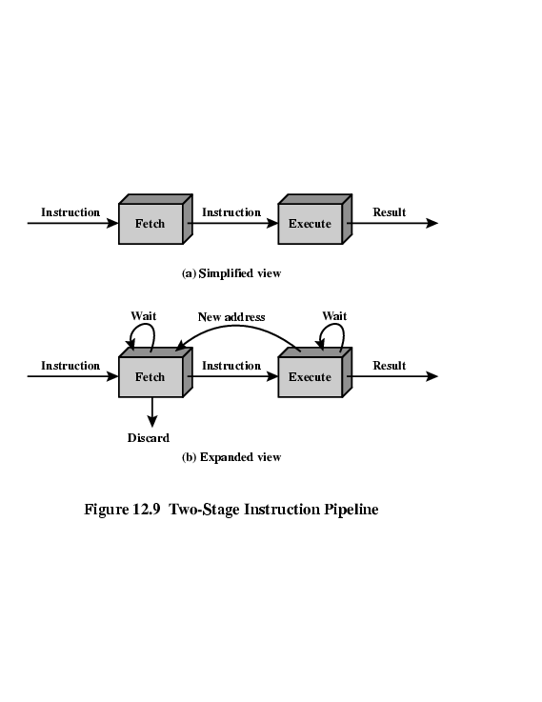
Two Stage Instruction Pipeline

Slide 32
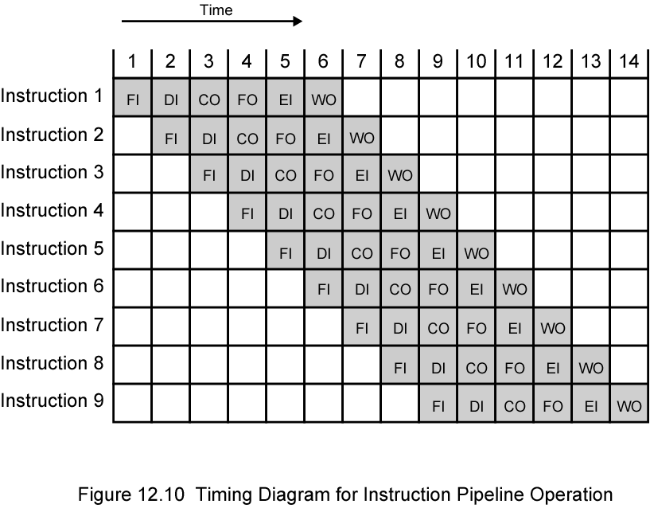
Timing Diagram for
Instruction Pipeline Operation
Notes:
39

Slide 33
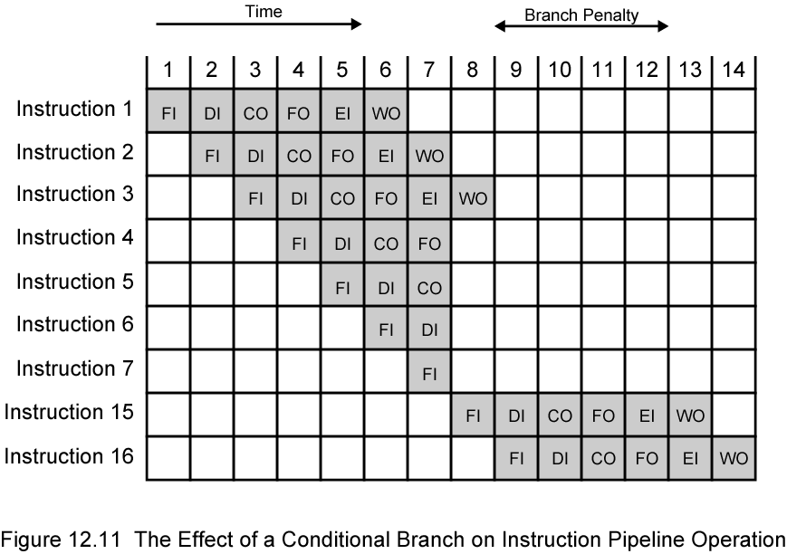
The Effect of a Conditional Branch on Instruction Pipeline Operation
Notes:
40

Slide 34
Problem
Assume an 8088 is executing a program in which the probability of a program jump is 0.1.For simplicity,assume that all instructions are 2 bytes long. a. What fraction of instruction fetch bus cycles is wasted? b. Repeat if the instruction queue is 8 bytes long.

Slide 35
problem
The occurrence of a program jump wastes up to 4 bus cycles (corresponding to the 4 bytes in the instruction queue when the jump is encountered). For 100 instructions, the number of nonwasted bus cycles is, on average, 90 × 2 = 180.
The number wasted is as high as 10 × 4 = 40. Therefore the fraction of wasted cycles is 40/(180 + 40) = 0.18.

Slide 36
problem
12.7 Consider the timing diagram of Figures 12.10.Assume that there is only a two-stage pipeline (fetch,execute).Redraw the diagram to show how many time units are now needed for four instructions.

Slide 37
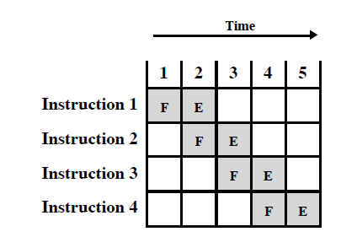
Answer

Slide 38
Question
12.8 Assume a pipeline with four stages:fetch instruction (FI),decode instruction and cal- culate addresses (DA),fetch operand (FO),and execute (EX).Draw a diagram simi- lar to Figures 12.10 for a sequence of 7 instructions,in which the third instruction is a branch that is taken and in which there are no data dependencies.

Slide 39
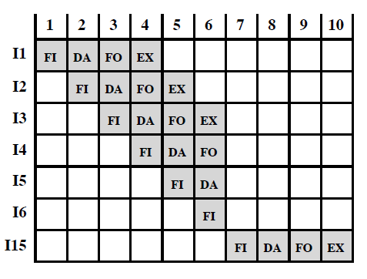
Answer

Slide 40
12.9 A pipelined processor has a clock rate of 2.5 GHz and executes a program with 1.5 million instructions.The pipeline has five stages,and instructions are issued at a rate of one per clock cycle. Ignore penalties due to branch instructions and out- of-sequence executions. a. What is the speedup of this processor for this program compared to a non- pipelined processor,making the same assumptions used in Section 12.4? b. What is throughput (in MIPS) of the pipelined processor?

Slide 41
Answer
We can ignore the initial filling up of the pipeline and the final emptying of the pipeline, because this involves only a few instructions out of 1.5 million instructions. Therefore the speedup is a factor of five.
One instruction is completed per clock cycle, for an throughput of 2500 MIPS.

Slide 42
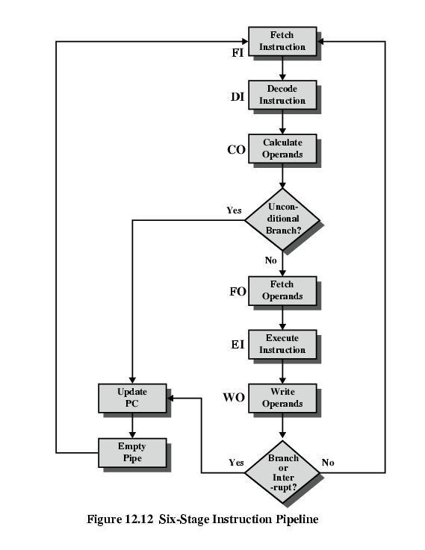
Six Stage
Instruction Pipeline

Slide 43
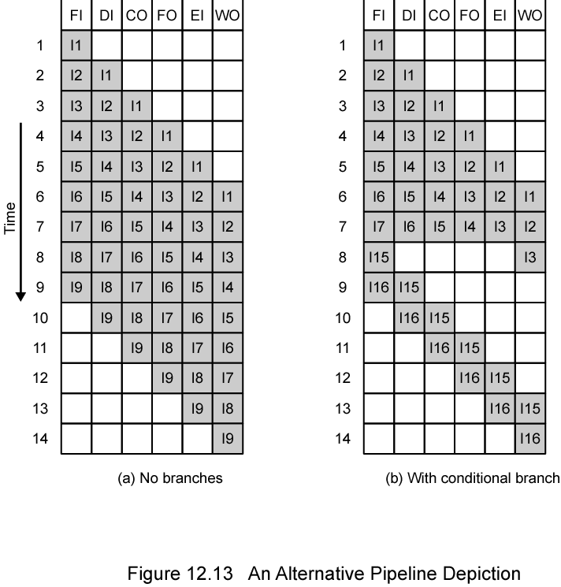
Alternative Pipeline Depiction

Slide 44
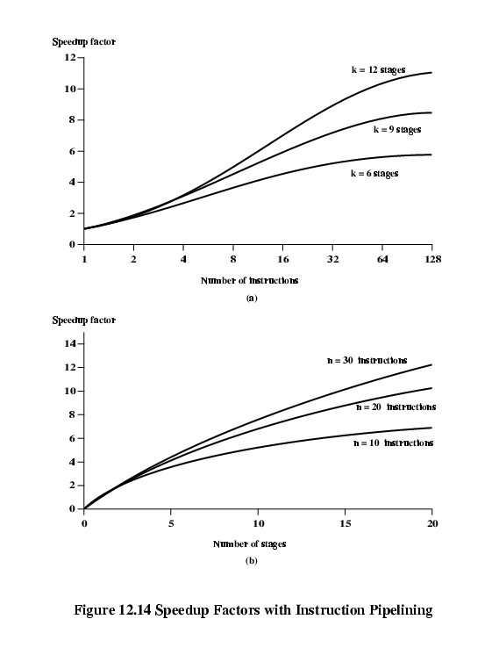
Speedup Factors with Instruction
Pipelining

Slide 45
Dealing with Branches
Multiple Streams
Prefetch Branch Target
Loop buffer
Branch prediction
Delayed branching
Notes:
41

Slide 46
Multiple Streams
Have two pipelines
Prefetch each branch into a separate pipeline
Use appropriate pipeline
Leads to bus & register contention
Multiple branches lead to further pipelines being needed
Notes:
42

Slide 47
Prefetch Branch Target
Target of branch is prefetched in addition to instructions following branch
Keep target until branch is executed
Used by IBM 360/91
Notes:
43

Slide 48
Loop Buffer
Very fast memory
Maintained by fetch stage of pipeline
Check buffer before fetching from memory
Very good for small loops or jumps
c.f. cache
Used by CRAY-1
Notes:
44

Slide 49
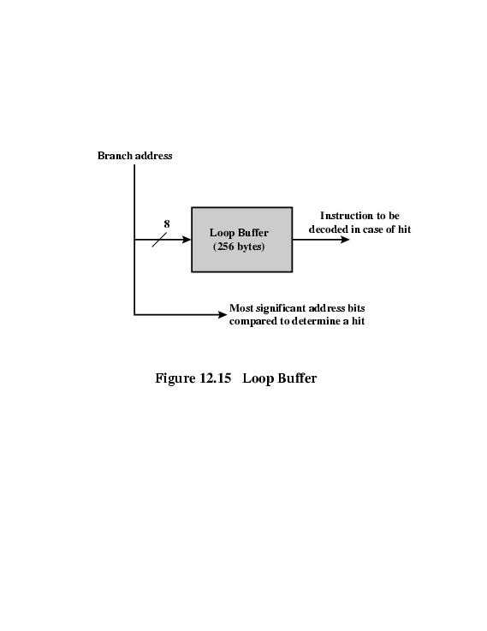
Loop Buffer Diagram

Slide 50
Branch Prediction (1)
Predict never taken
  Assume that jump will not happen
  Always fetch next instruction
  68020 & VAX 11/780
  VAX will not prefetch after branch if a page fault would result (O/S v CPU design)
Predict always taken
  Assume that jump will happen
  Always fetch target instruction
Notes:
45

Slide 51
Branch Prediction (2)
Predict by Opcode
  Some instructions are more likely to result in a jump than thers
  Can get up to 75% success
Taken/Not taken switch
  Based on previous history
  Good for loops
Notes:
46

Slide 52
Branch Prediction (3)
Delayed Branch
  Do not take jump until you have to
  Rearrange instructions
Notes:
47

Slide 53
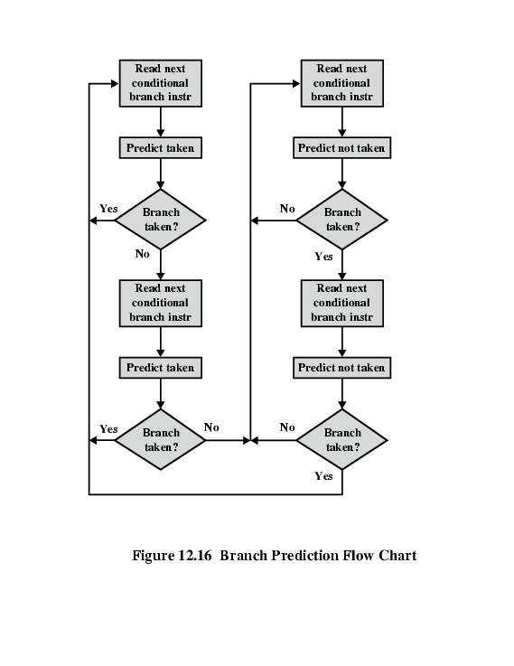
Branch Prediction Flowchart

Slide 54
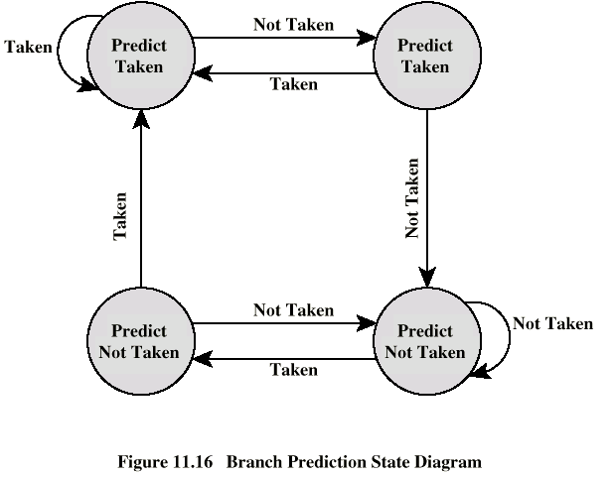
Branch Prediction State Diagram

Slide 55
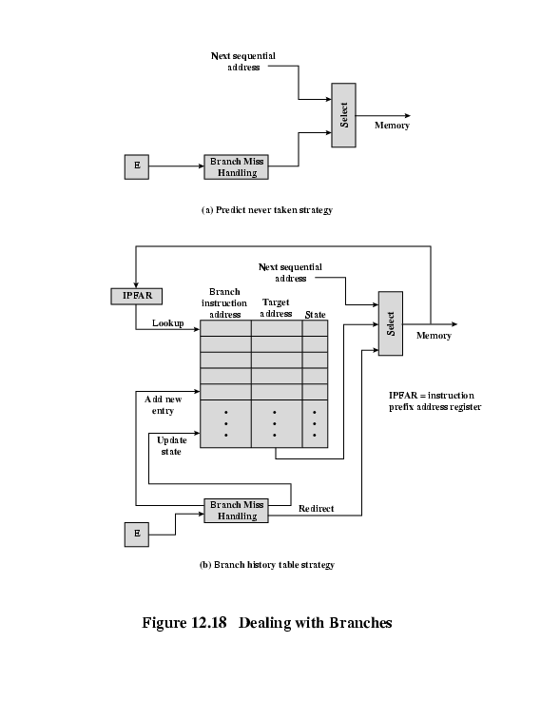
Dealing With
Branches

Slide 56
Intel 80486 Pipelining
Fetch
  From cache or external memory
  Put in one of two 16-byte prefetch buffers
  Fill buffer with new data as soon as old data consumed
  Average 5 instructions fetched per load
  Independent of other stages to keep buffers full
Decode stage 1
  Opcode & address-mode info
  At most first 3 bytes of instruction
  Can direct D2 stage to get rest of instruction
Decode stage 2
  Expand opcode into control signals
  Computation of complex address modes
Execute
  ALU operations, cache access, register update
Writeback
  Update registers & flags
  Results sent to cache & bus interface write buffers

Slide 57
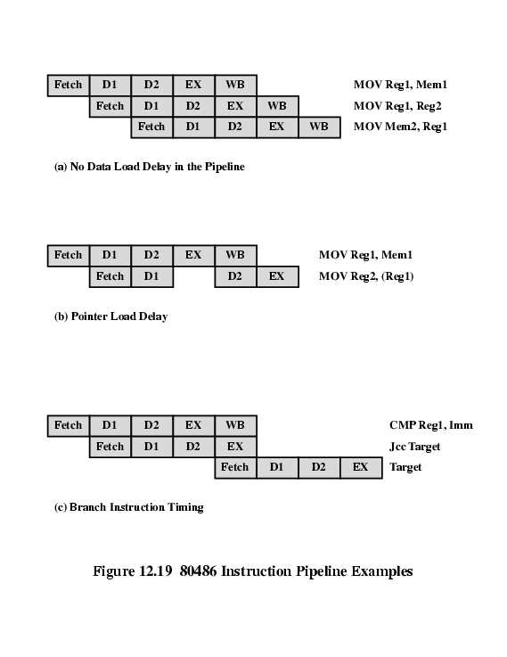
80486 Instruction Pipeline Examples

Slide 58
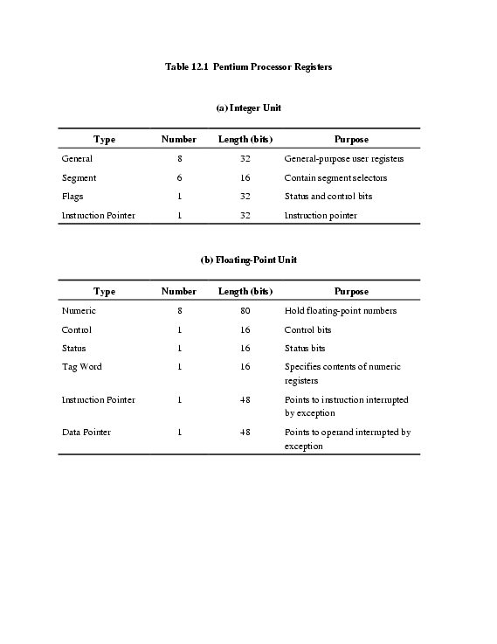
Pentium 4 Registers

Slide 59
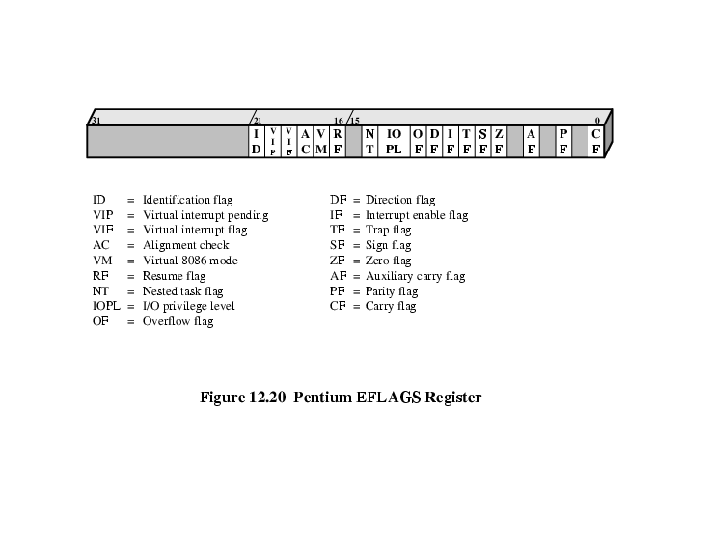
EFLAGS Register

Slide 60
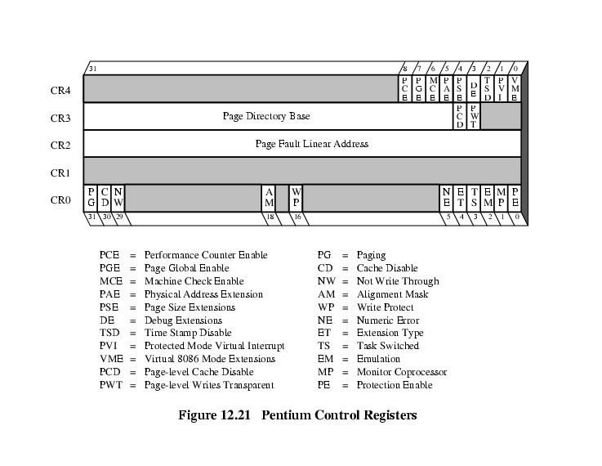
Control Registers

Slide 61
MMX Register Mapping
MMX uses several 64 bit data types
Use 3 bit register address fields
  8 registers
No MMX specific registers
  Aliasing to lower 64 bits of existing floating point registers

Slide 62
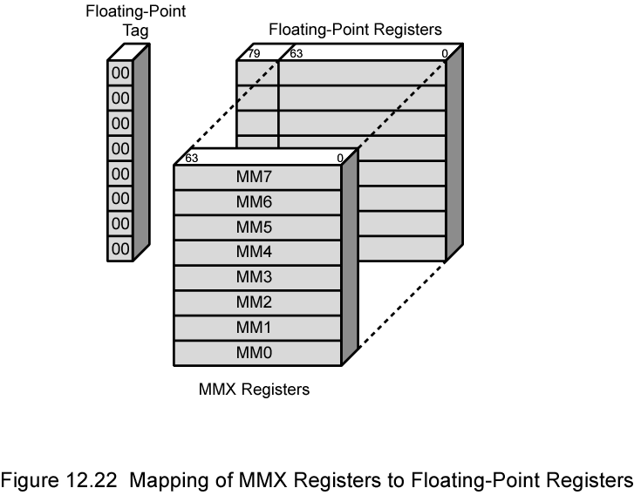
Mapping of MMX Registers to
Floating-Point Registers

Slide 63
Pentium Interrupt Processing
Interrupts
  Maskable
  Nonmaskable
Exceptions
  Processor detected
  Programmed
Interrupt vector table
  Each interrupt type assigned a number
  Index to vector table
  256 * 32 bit interrupt vectors
5 priority classes

Slide 64
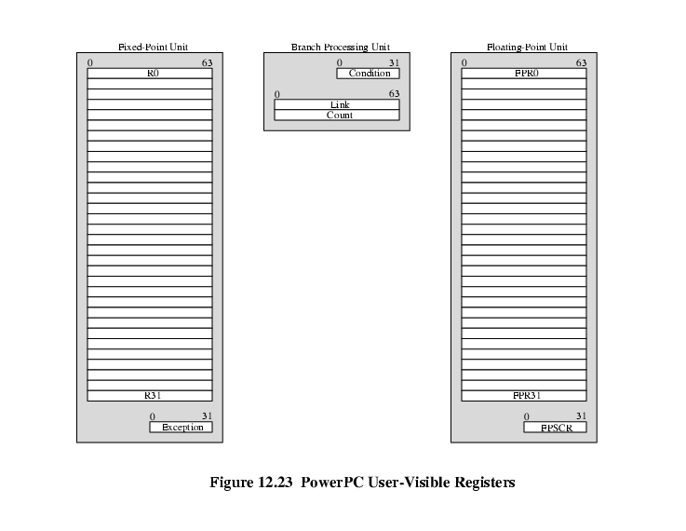
PowerPC User Visible Registers

Slide 65
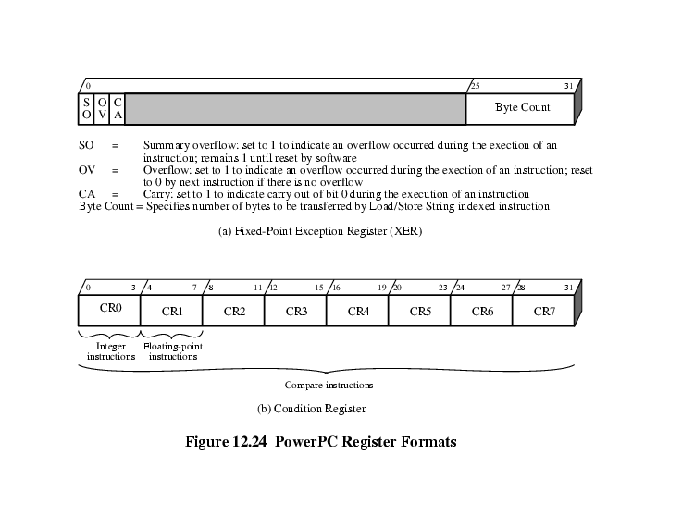
PowerPC Register Formats

Slide 66
Foreground Reading
Processor examples
Stallings Chapter 12
Manufacturer web sites & specs
Notes:
48

Slide 67
Research Assignment
Opportunities and challenges in Processor Pipe lining

